Slide 1

MILOS
Minimum Level Stock System With Visualization Stock In Chutter At BF43 Armature
Mochammad Aditya Firmansyah
Ripan
(DM2260931)
(DM2260933)
Mochammad Aditya Firmansyah
Ripan
(DM2260931)
(DM2260933)

Slide 2




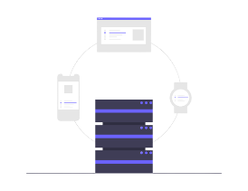







Minimum Level Stock By
“Minimum Level Stock”
Smart Inventory System
0
Part
Shortage
Current Condition
Minimizing stock in the chutter with controlling chart. Get early information about level stock.
No Mieruka Data Stock at Chutter
1 day = 3-4 dandori
Loss time = 10-20 minutes
ROP = 65% – 75%
Because there is no stock, often dandori
Manual Data Logging = Long Cycle Time
1
Visualize Data & Integrate System E-Kanban
1
2
3
Using a web system to display the amount of stock in the chutter. Using E-Kanban for controlling stock out
There is no visualization of the number of stock parts on the F/G chutter. And E-Kanban not use for control stock.
Stock Out Manual filling and not controlling
1 Fill = 30 Second (Loss Time)
1 Day = 8 Fill = 8 X 30 = 240 Second (Loss Time)
2
Warning System For preventive
Part Shortage Because Additional Schedule
Purpose
Get early notification when part will be in shortage and the scheduled production of assembly line
What we do?
3
Digitalize Stock Out Form, and Level Stock
Changing Working style to digital to improve accuracy in data logging and reduce cycle time
Visualize Data stock at chutter F/g using website
Integrate Scanner system for stock in qty
Notification Priority part based on assy line needed & Warning System earlier when part will shortage
Increase Productivity
Manual Stock In
Benefits
Manual stock Out
Web System
Reduce Cycle time with streamline the work process
Double Job
One job for the same result
30 Second
15 Second
Integrate Scanner for stock out realtime data
QR Code for system Stock In and Stock out
Prevent Part Shortage
Manual Stock In Out
Get early notification level stock in chutter
TARGET PROJECT
Visualize Data of
Level stock in F/G S/A
Part Priority based on scheduling Assy Line
Reduce Additional Schedule for reduce Dandori
1 Day = 1-2 Dandori
Loss Time = 5-10 minutes
ROP = 80-90 %
Reduce Cycle time for filling Stock out form
1 process scan = 15 Second
1 Day = 8 X 15 = 120 Second
Mochammad Aditya Firmansyah
Ripan
(DM2260931)
(DM2260933)

Slide 3
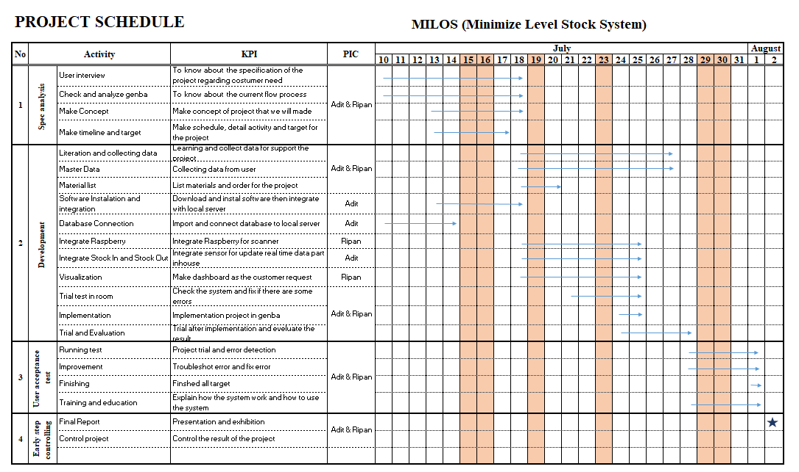
SCHEDULE PROJECT
:
Planning
:
Actual
:
Due Date
:
No Working Day

Slide 4
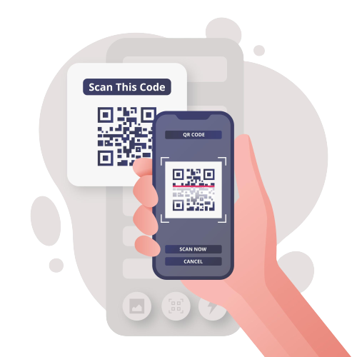
FLOW PROCESS
*Was the scan successful?
Part OK?
Yes
Take and Scan Kanban
Yes
A
Start
Part In Visual inspection
Check by operator
Level stock Update
Put Kanban on box part OK
Put box on F/G store
*Are the parts OK?
No
No
B
Yes
Check leader
Put on NG box
Fill In Qty adjustment form
No
Scrap
B
*Was the scan successful?
A
Scan out box to be taken
Yes
BOP take scanner in F/G Store
Level stock Update
BOP take the part
End
No
Fill In Qty adjustment form

Slide 5
FLOW SYSTEM
TRANSACTION DETAIL ADJUSTMENT FORM
*Is the part number listed in the database?
Check part Number
Yes
Check Qty Before
Fill New Qty
Update Table Inventory
Qty Adjustment
End
No
Process by Computer
*The part number is not registered, register the part number in the database by the admin.
Call Admin
End
Database
Process by Manual
*The maximum limit value must be above the minimum limit value
*Is the part number listed in the database?
Sequence Line
Check Part Number
Yes
Check Limit Min & Max Before
Fill New Limit
Update Limit Table Level Stock
Min & Max Adjustment
End
No
*The part number is not registered, register the part number in the database by the admin.
Call Admin
End

Slide 6
FLOW SYSTEM
TRANSACTION DETAIL STOCK IN
Stock In
Scan Kanban Stock In
Scan Success?
No
Fill Qty adjustment
End
Process by Computer
Yes
Database
Process by Manual
Check Qty and Part Number
Sequence Line
Update Stock
Update Table inventory
Insert History Stock In
Update Level Stock
End

Slide 7
FLOW SYSTEM
TRANSACTION DETAIL STOCK OUT
Stock out
Success Scan?
No
Fill Qty Adjustment
Scan Kanban Stock Out
End
Yes
Process by Computer
Check Max & Min Stock
Database
Process by Manual
Sequence Line
*Is the Stock below or above the Max & Min limits?
Table Level Stock
Yes
Warning Notification
Klik Ok and take action
End
No
Update Stock
Update Table inventory
Insert History Stock Out
Update Table Qty Sa
End

Slide 8
FLOW SYSTEM
TRANSACTION DETAIL LOGIN FORM
Login
*Wifi connect to DMIA/Local wifi
Success?
No
Open page
Check Connection
Refresh page
End
Yes
Process by Computer
Fill username and Password
Update Table User
Database
*Make sure fill with correct data
Process by Manual
No
*Admin SD
Sequence Line
*Is the username exist in database ?
Success Login?
Username and Password not found
Call admin
Insert new user
Yes
Open page Index
End

Slide 9
FLOW SYSTEM
DATABASE INFORMATION
As data information and record data schedule that must be made, and have been made
Table Inventory
Table Qty Sa
Table Assy Schedule
Show Qty (pcs) in F/G store Sub Assy BF43 Armature Line 1
Table of history stock out that always update
Table Users
Table LeadTime
Table Dekidaka stock
As a reference for the maximum and minimum stock limits available
Table of users who have access for open the page
Table of history lead time each part number

Slide 10
RESULT PROJECT

Slide 11
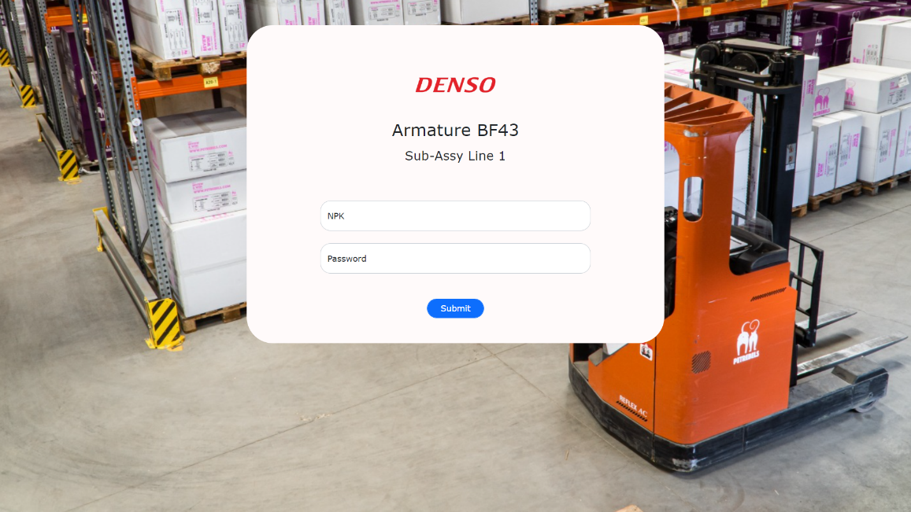
RESULT PROJECT
1
Create a login feature.
Login System
Used to access and control the stock level web system.
Example
NPK : DM2260900
Password : BF43

Slide 12
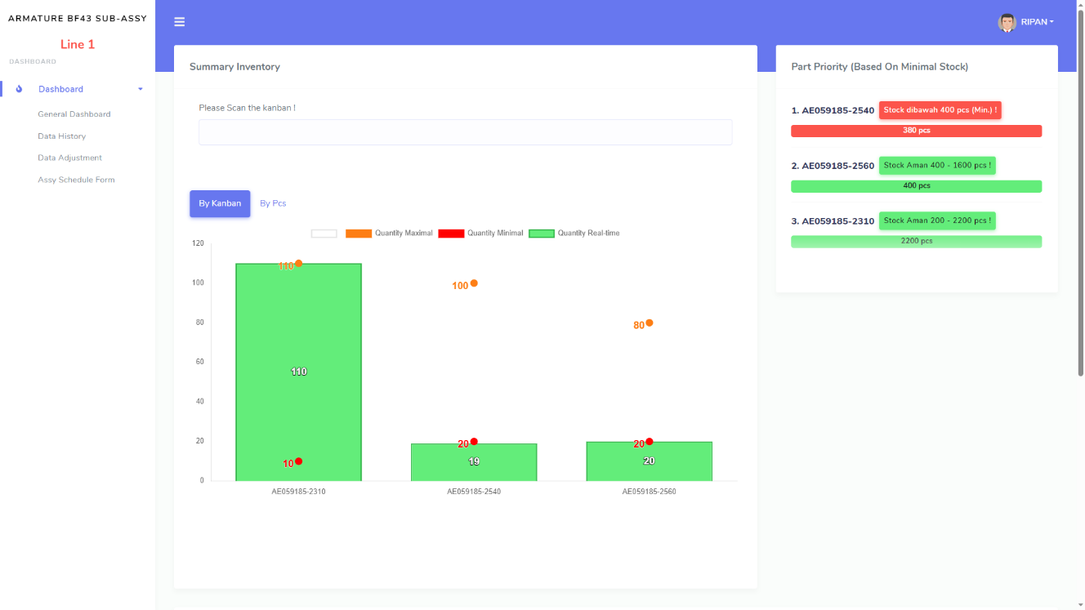
RESULT PROJECT
2
Create Visualization of Level Stock
Select By Kanban / Pcs
Limit Max Qty
Chart Level Stock
This chart shows the amount of stock for each part number in the F/G chutter
QTY Real
Limit Min Qty
Part Number

